Slide 1

E-Commerce Intelligence Platform for Customer Churn and Sales Prediction Using Classification and Customer Behaviour Mining
CSA1613-DATA WAREHOUSING AND DATA MINING
GUIDED BY: Dr.S.RENUGA
Presented by:-
192372301- G Charan Teja
192324161-U Madhu Sudhan
192525050 -Ashwin Chris
192572037 -Siva Balan K

Slide 2


Abstract
The E-Commerce Intelligence Platform for Customer Churn and Sales Prediction Using Classification and Customer Behaviour Mining is designed to analyze customer data and predict customer churn and future sales using machine learning techniques. The system uses data such as purchase history, order frequency, spending patterns, browsing activity, and customer preferences to understand customer behaviour. Classification algorithms are used to identify customers who are likely to stop purchasing, while customer behaviour mining helps discover shopping patterns and purchasing trends. Sales prediction techniques are applied to estimate future sales based on historical transaction data. The platform provides useful insights through dashboards, visualizations, and prediction reports, helping e-commerce businesses improve customer retention, develop effective marketing strategies, increase sales, and make better business decisions.

Slide 3
Introduction
E-Commerce Data Analysis: Analyzes customer purchase history, spending patterns, and shopping activities to understand customer behaviour.
Customer Churn Prediction: Uses machine learning classification algorithms to identify customers who may stop purchasing from the platform.
Sales Prediction: Predicts future sales using historical sales data and identifies customer purchasing trends.
Business Improvement: Helps businesses improve customer retention, develop effective marketing strategies, and increase sales and profitability.

Slide 4
Problem Statement
Customer Churn: E-commerce businesses find it difficult to identify customers who are likely to stop purchasing.
Sales Prediction: Predicting future sales accurately is challenging due to changing customer preferences and purchasing patterns.
Customer Behaviour Analysis: Understanding customer shopping habits and preferences from large amounts of data is difficult using traditional methods.
Lack of Intelligent Insights: Businesses need a machine learning-based platform to predict customer churn, forecast sales, and support better business decisions.

Slide 5
Objectives
Predict Customer Churn: Identify customers who are likely to stop purchasing using machine learning classification algorithms.
Forecast Sales: Predict future sales based on historical transaction data and purchasing trends.
Analyze Customer Behaviour: Discover customer preferences, shopping patterns, and purchase frequency using data mining techniques.
Improve Business Performance: Help e-commerce businesses increase customer retention, optimize marketing strategies, and improve sales.

Slide 6
Literature Review
S.NO | Research Paper | Author | Advantages | Disadvantages | Technologies Used
1 | Hybrid Convolutional Long Short-Term Memory Models for Sales Forecasting in Retail (2024) | Refer to the published paper | Captures complex sales trends and temporal patterns | Requires sufficient historical data and computational resources | CNN, LSTM, Deep Learning
2 | E-Commerce Customer Churn Prediction for the Marketplace in Malaysia (2023) | Refer to the published paper | Helps identify customers likely to leave | Prediction quality depends on customer data | Machine Learning, Classification
3 | Prediction Model for E-Commerce User Purchase Behavior Based on Data Mining (2024) | Refer to the published paper | Identifies customer purchase patterns | May require extensive transaction data | Data Mining, FP-Growth

Slide 7
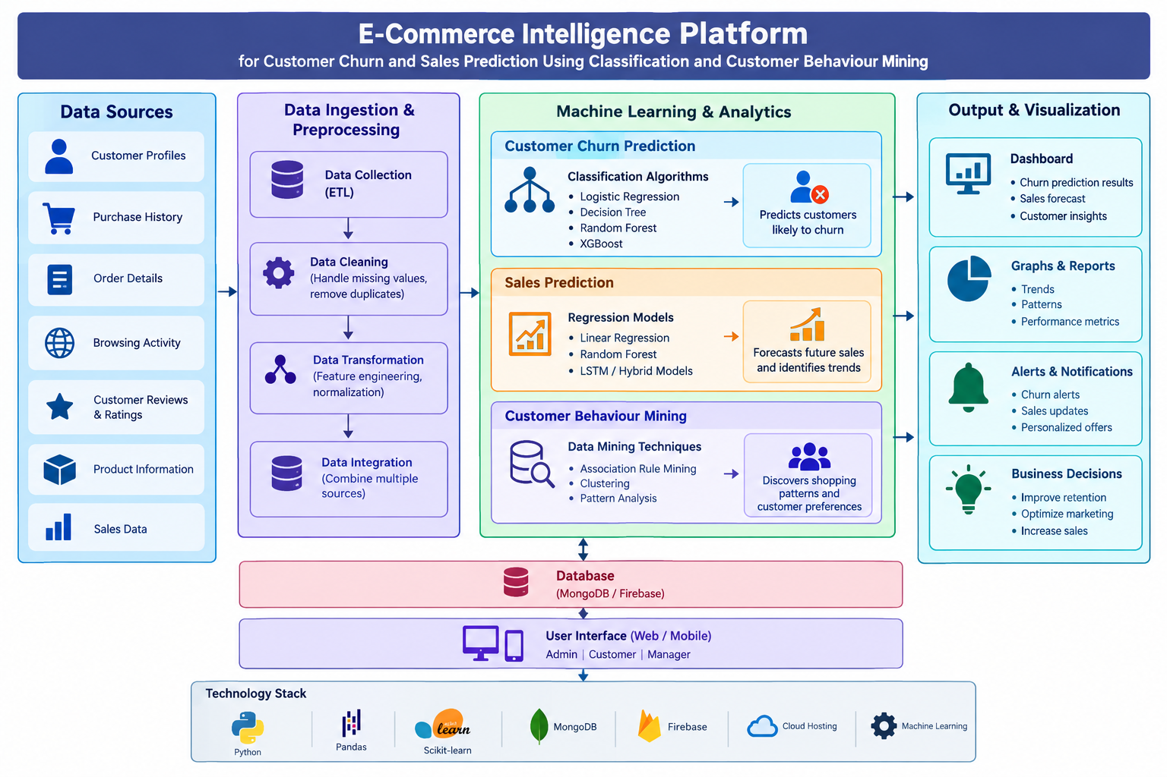
System Architecture

Slide 8
MODULE 1
Data Collection and Preprocessing
Data Collection: Collect customer details, purchase history, order information, and sales data from the e-commerce platform.
Data Cleaning: Remove duplicate data and correct missing or incorrect values to improve data quality.
Data Transformation: Convert the collected data into a proper format that machine learning algorithms can understand.
Data Integration: Combine all the cleaned data into a single dataset for customer churn prediction, sales prediction, and customer behaviour analysis.

Slide 9
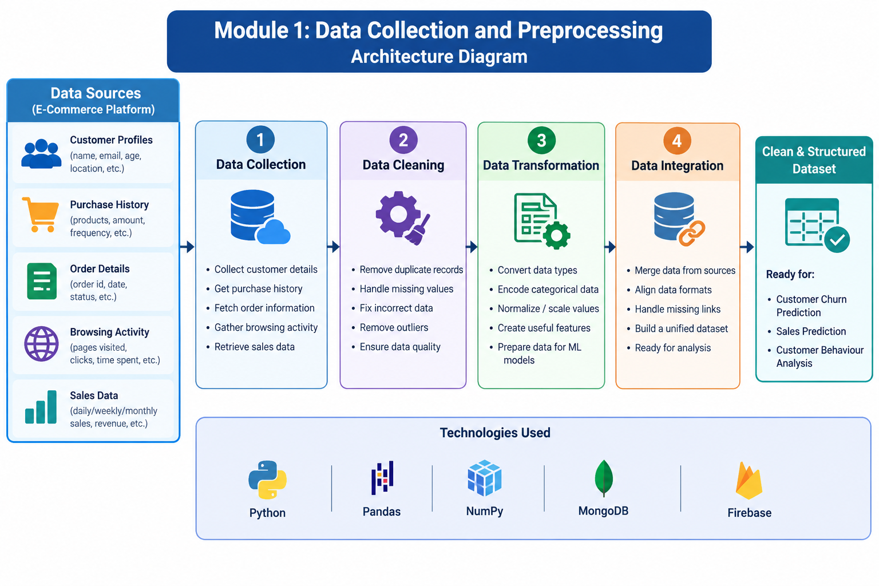
ARCHITECTURE DIAGRAM

Slide 10
MODULE 2
Customer Churn Prediction
Data Analysis: Analyze customer purchase history, order frequency, spending patterns, and activity to understand customer behaviour.
Feature Selection: Select important customer details, such as purchase frequency, time since last purchase, and total spending, for prediction.
Classification Algorithms: Apply machine learning algorithms such as Logistic Regression, Decision Tree, and Random Forest to predict customer churn.
Churn Prediction Results: Classify customers as likely to churn or likely to continue purchasing, helping businesses take steps to improve customer retention.

Slide 11
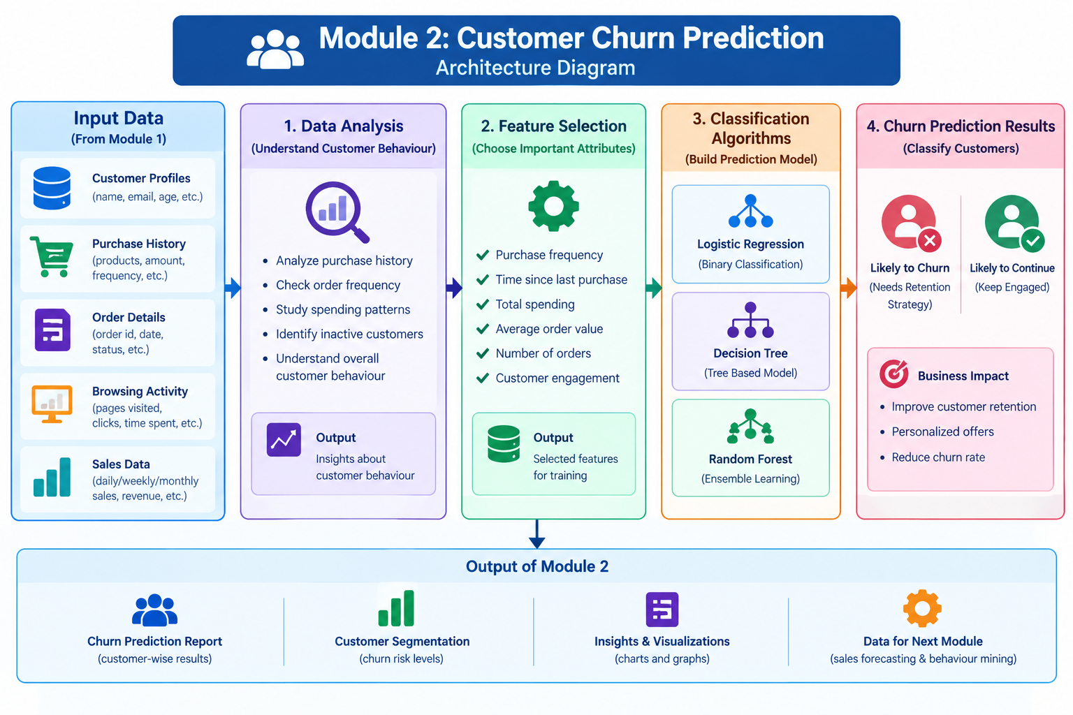
ARCHITECTURE DIAGRAM

Slide 12
MODULE 3
Sales Prediction and Forecasting
Sales Data Analysis: Analyze historical sales records, product details, order quantities, revenue, and purchasing trends.
Feature Selection: Select important factors such as previous sales, product demand, order frequency, and seasonal trends for prediction.
Sales Prediction: Apply machine learning algorithms such as Linear Regression, Random Forest, and LSTM to estimate future sales.
Sales Forecasting Results: Generate predicted sales reports and graphs to help businesses plan inventory, understand demand, and make better business decisions.

Slide 13
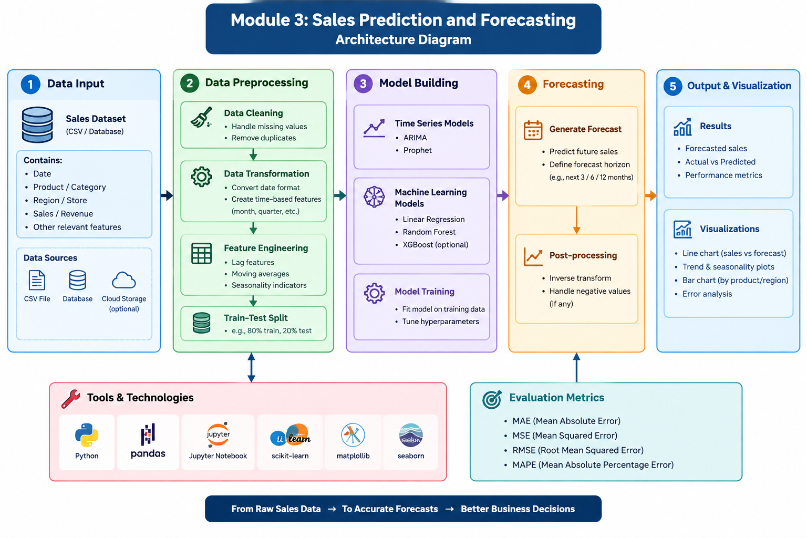
ARCHITECTURE DIAGRAM

Slide 14
MODULE 4
Customer Behaviour Mining and Intelligence Dashboard
Customer Behaviour Analysis – Analyze customer purchase history, browsing activity, and spending patterns to understand customer preferences.
Customer Segmentation – Group customers based on purchasing behaviour, spending habits, and purchase frequency.
Intelligence Dashboard – Display customer churn predictions, sales forecasts, and customer behaviour insights using interactive charts.
Business Insights and Recommendations – Generate data-driven reports to improve customer retention, optimize sales, and support business decisions.

Slide 15
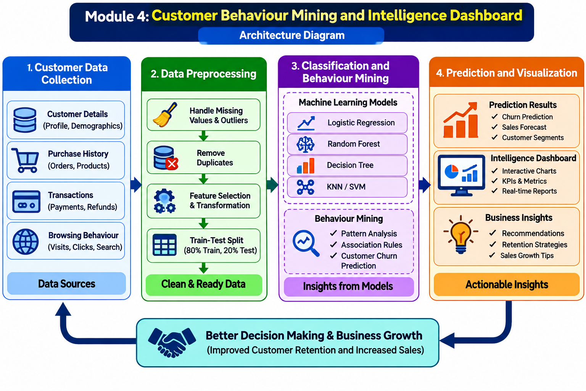
ARCHITECTURE DIAGRAM

Slide 16
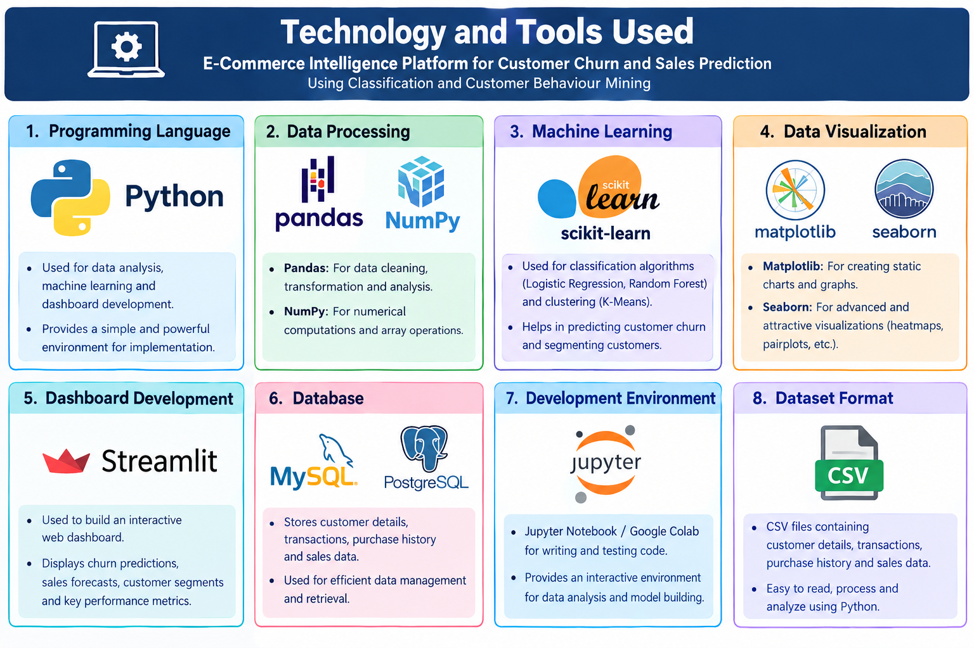
Technology and Tools Used

Slide 17

Challenges & Limitations
Data Quality Issues – Missing, duplicate, or inaccurate customer data may reduce prediction accuracy.
Model Accuracy – Machine learning models may not always predict customer churn and sales correctly.
Data Privacy and Security – Protecting sensitive customer information is essential.
Scalability and Performance – Processing large volumes of e-commerce data may require additional computing resources.

Slide 18
CONCLUSION
Customer Churn Prediction: Identifies customers who are likely to stop purchasing using machine learning algorithms.
Sales Forecasting: Predicts future sales trends to support better business planning.
Customer Behaviour Analysis: Analyzes purchasing patterns and groups customers based on their behaviour.
Business Intelligence: Provides an interactive dashboard to improve customer retention, increase sales, and support data-driven decisions.

Slide 19
REFERENCE
Tang, H. Y., & Ya’acob, S. (2023). E-Commerce Customer Churn Prediction for the Marketplace in Malaysia. Open International Journal of Informatics. https://doi.org/10.11113/oiji2023.11n2.273
Performance Evaluation of Various Classification Techniques for Customer Churn Prediction in E-commerce. (2022). Microprocessors and Microsystems, 94, 104680. https://doi.org/10.1016/j.micpro.2022.104680
E-commerce Customer Churn Prevention Using Machine Learning-Based Business Intelligence Strategy. (2023). Measurement: Sensors, 27, 100728. https://doi.org/10.1016/j.measen.2023.100728
Scikit-learn Developers. Scikit-learn User Guide: Classification and Clustering. https://scikit-learn.org/stable/user_guide.html
Streamlit Developers. Streamlit Documentation: Data Visualization and Interactive Dashboards.https://docs.streamlit.io/

Slide 20
Thank You

